Slide 1
Introduction to WireShark

Slide 2
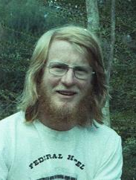
Who Am I?
Wrote my first program in Fortran in 1971
Joined the industry full time in 1976
Built my first Ethernet network in 1984
Have worked as
Component level repair technician
National technical support
National Support and Training Manager
Product Marketing Manager
Systems Engineering Manager
Corporate Evangelist
Country Manager
University Lecturer

Slide 3
What is WireShark?

Slide 4
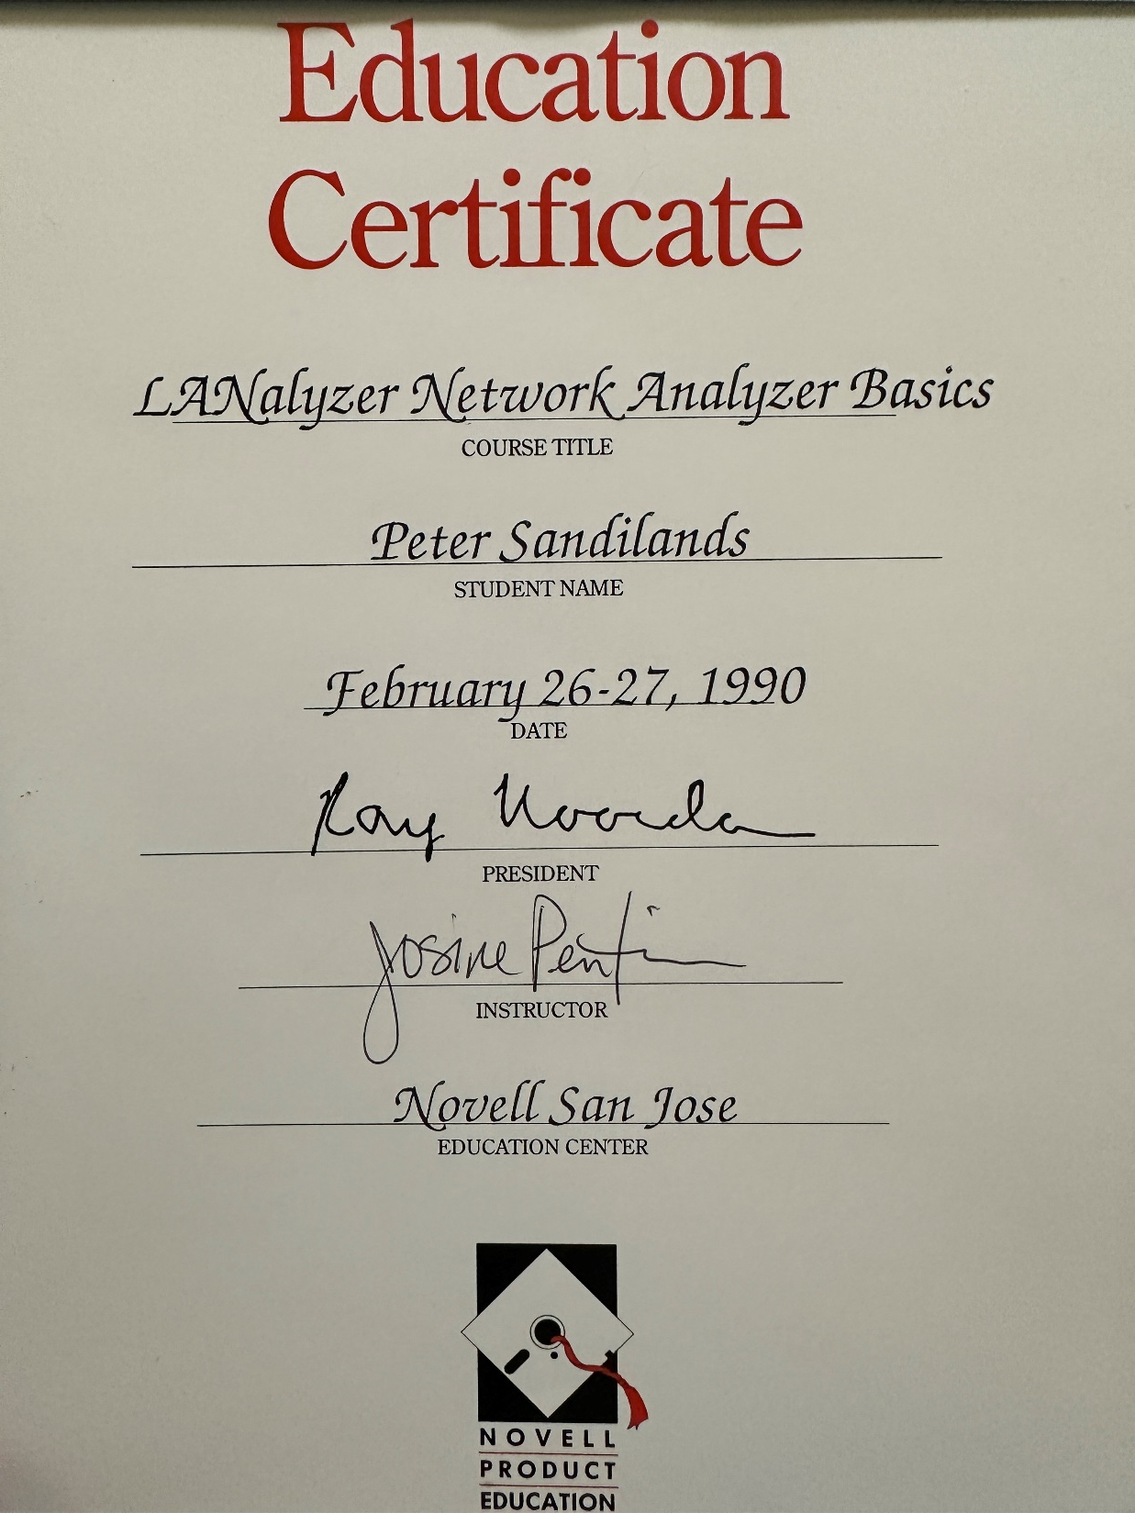

Slide 5
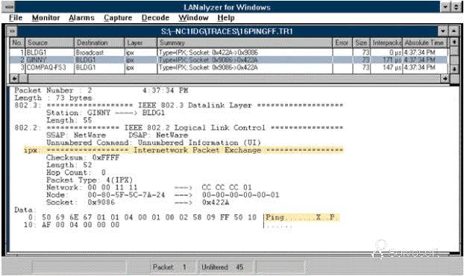

Slide 6
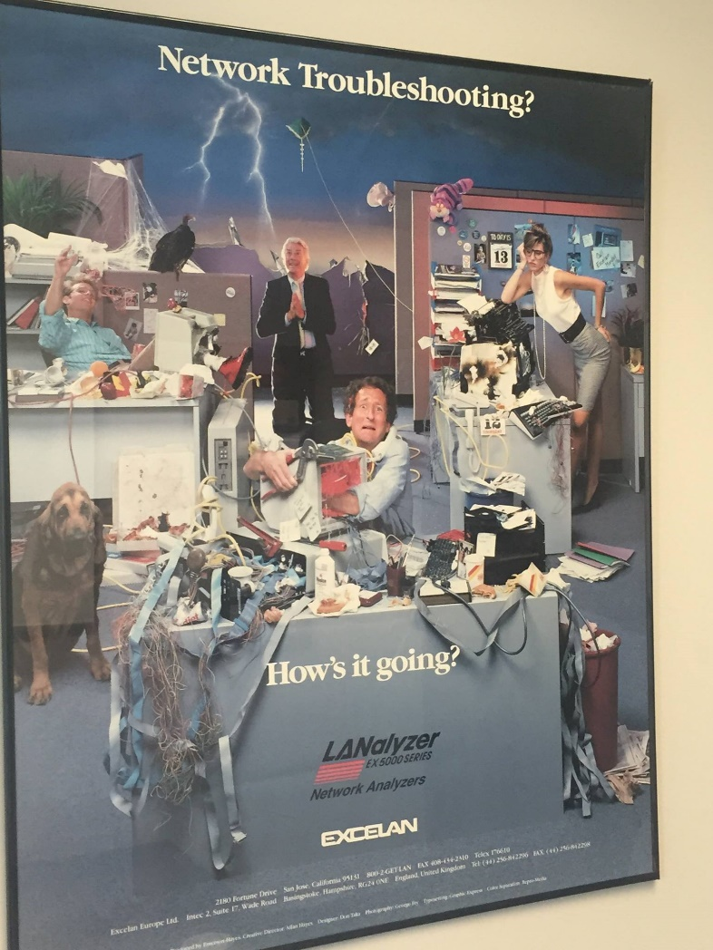

Slide 7

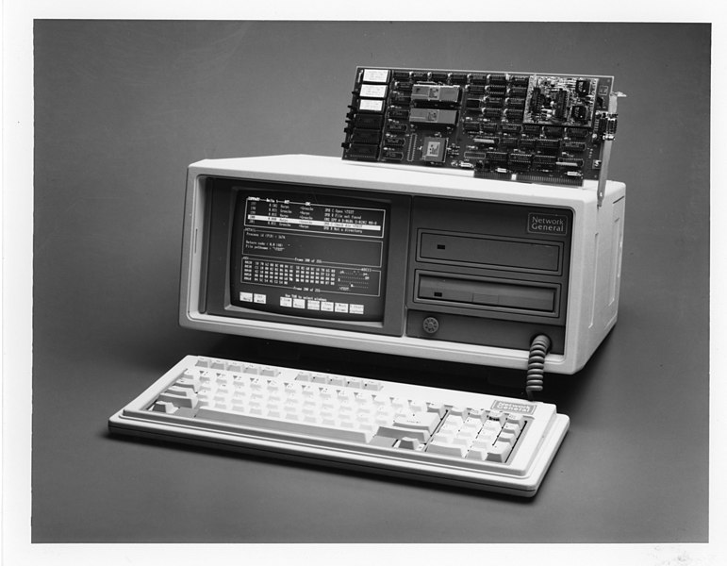
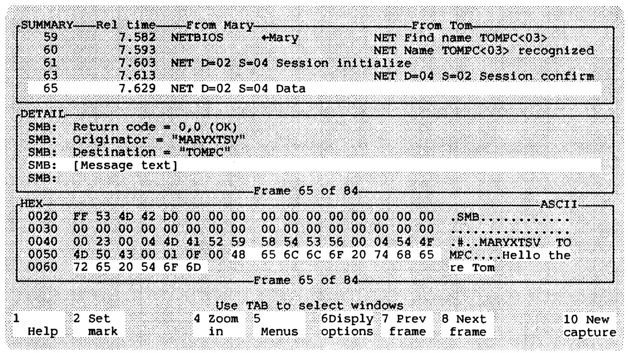

Slide 8
https://www.youtube.com/watch?v=1u2W0frSCgs Laura Chappell Lanalyzer for Windows
Packets for today https://drive.google.com/drive/folders/1L2wbVa4AmF-7Kkqhl5Rqn8GjpyFbhCUW?usp=sharing
https://nostarch.com/download/ppa3ecaptures_updated.zip

Slide 9
How do we use it?

Slide 10
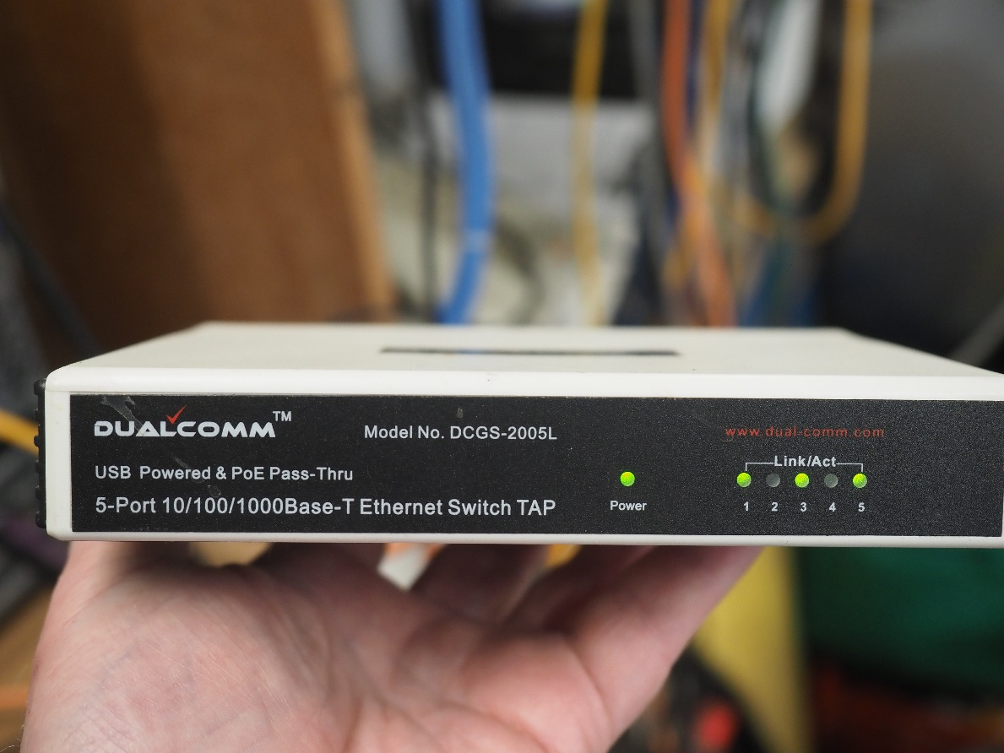
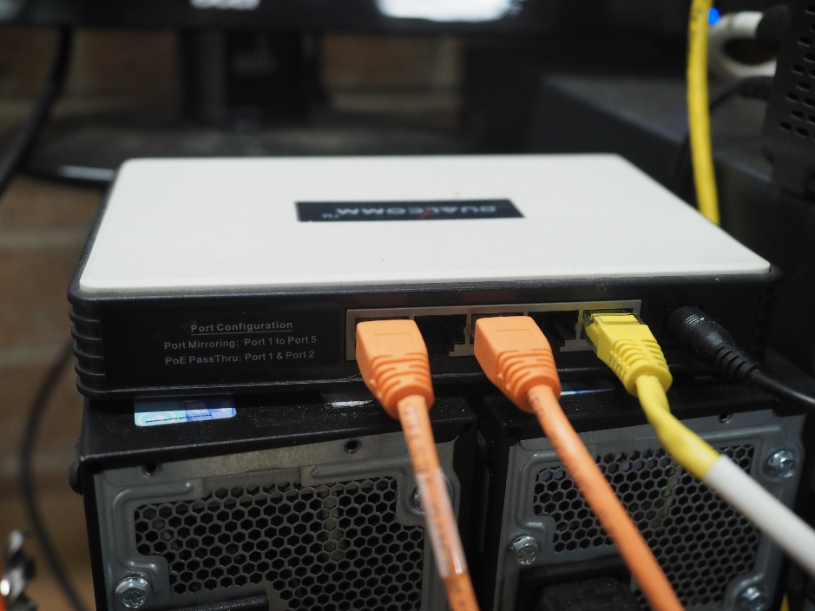
Network Access - Taps

Slide 11
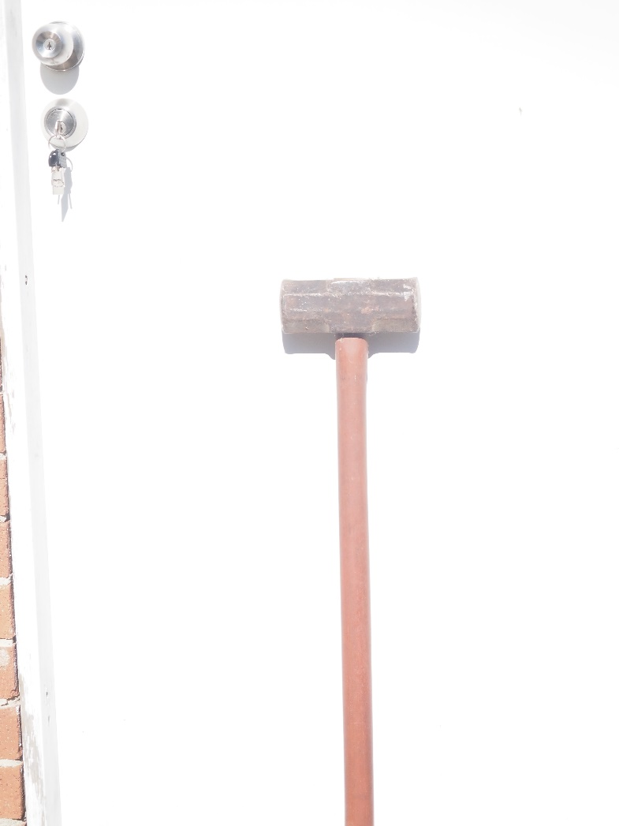
Raw WireShark

Slide 12
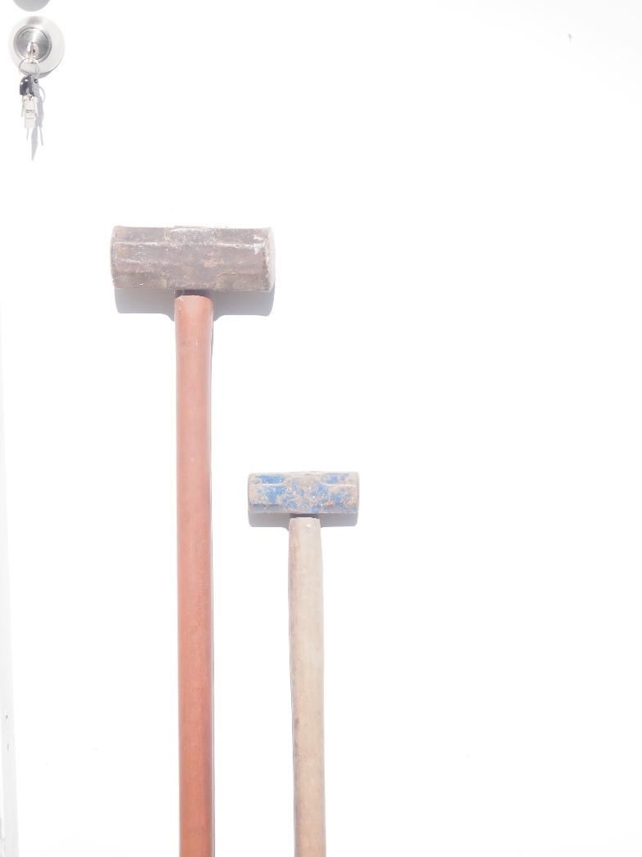
Less Raw

Slide 13
Capture Filters
Determine what is / is not captured
Syntax based on Berkeley Packet Filter (BPF)
Same as TCPDump

Slide 14
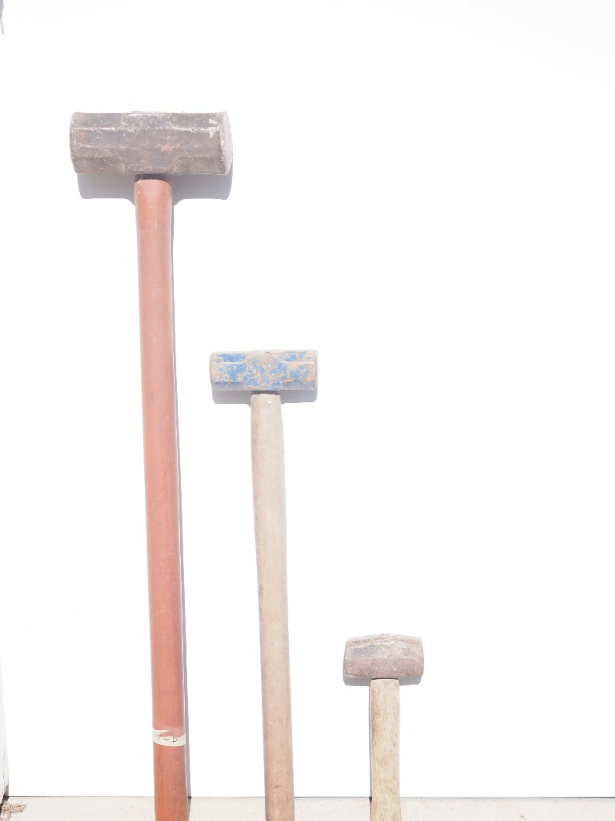
More refined

Slide 15
Display Filters
WireShark specific syntax

Slide 16
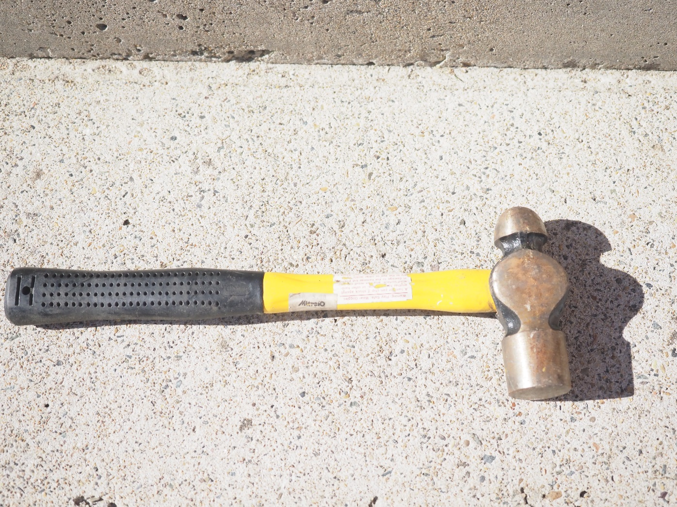
Detail oriented

Slide 17
Coloring Rules
Highlight packets based on
Addressing
Protocols
Data

Slide 18
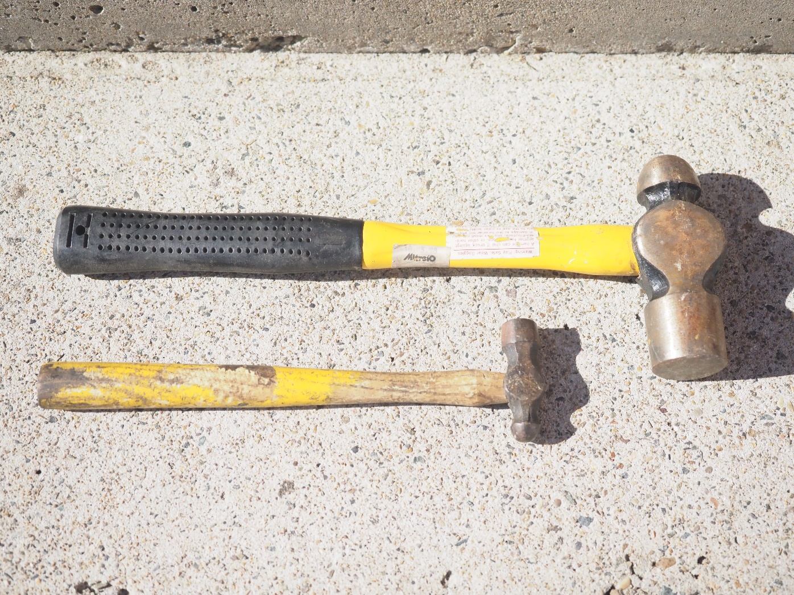
Task specific

Slide 19
Profiles
Linux user? Think of them like workspaces
Windows user? Different users
Configures WireShark to act and look differently
Capture filters
Display filers
Colouring rules

Slide 20


